Slide 1


Slide 2

Project Overview: Dating App Data Analysis
This project focuses on analyzing user behavior, subscription patterns, and relationship preferences in a dating app platform using SQL Server. The dataset is synthetically generated to simulate a real-world dating application where users interact through swipes, subscriptions, and matches.
The primary goal is to extract business insights that can help improve user experience, optimize marketing strategies, and enhance platform performance.
Objective
Understand user demographics and app usage patterns.
Identify the most active users and their behaviors.
Analyze subscription plans and revenue generation.
Discover the relationship between education level, occupation, and spending habits.
Identify the most popular relationship preferences by region.

Slide 3
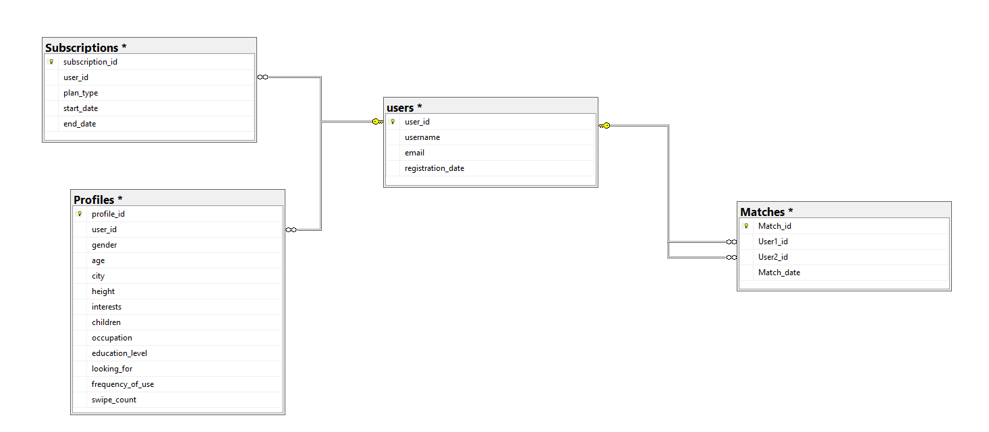
ER DIAGRAM

Slide 4
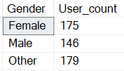
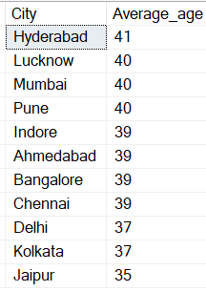
1. Gender Distribution
select Gender, Count(*) as User_count from Profiles
group by Gender;
2. Average Age of Users by City
select City, avg(age) as Average_age from profiles
group by City
order by avg(age) desc;

Slide 5
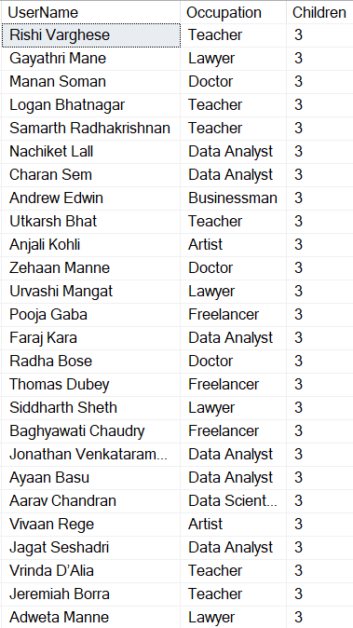

3. Users with Children and Their Occupations
select u.UserName, p.Occupation, p.Children from Profiles as p
inner join Users as u on u.user_id = p.user_id
where p.Children >0
order by Children desc;

Slide 6
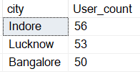
4. Top 3 Cities with Highest Number of Users
select top 3 city, count(*) as User_count from profiles
Group by city
order by count(*) desc;

Slide 7
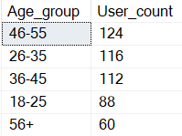
5. Age Group Usage Analysis
select case
when age between 18 and 25 then '18-25'
when age between 26 and 35 then '26-35'
when age between 36 and 45 then '36-45'
when age between 46 and 55 then '46-55'
else '56+' end as Age_group,
count(*) as User_count
from profiles
group by case
when age between 18 and 25 then '18-25'
when age between 26 and 35 then '26-35'
when age between 36 and 45 then '36-45'
when age between 46 and 55 then '46-55'
else '56+' end
order by count(*) desc;

Slide 8
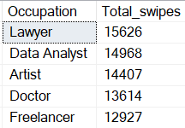
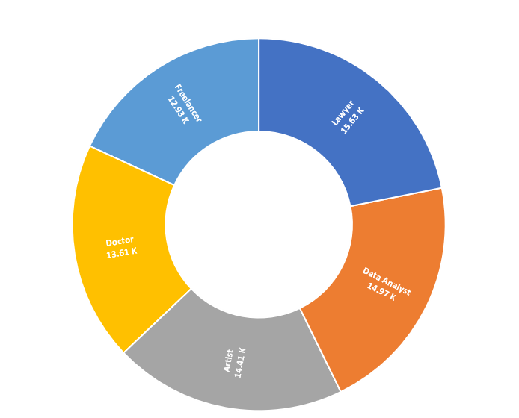
6. Top 5 Occupations with Highest Swipe Counts
select top 5 Occupation, sum(Swipe_count) as Total_swipes
From Profiles
group by Occupation
Order By sum(Swipe_count) desc;

Slide 9
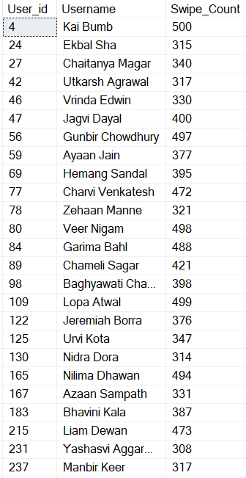

7. Users with More Than 300 Swipes in Last 6 Months
select p.User_id, u.Username, p.Swipe_Count
from Profiles as p
inner join Users as u on u.user_id = p.User_id
where p.swipe_count > 300
and u.registration_date > dateadd(month,-6,getdate());

Slide 10
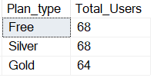
8. Paid Subscribers by Plan Type
select Plan_type, count(*) as Total_Users
from subscriptions
group by Plan_type
Order by count(*) desc;

Slide 11

9. Revenue by Subscription Plans
Select Plan_type,
sum(case when plan_type = 'silver' then 999
when plan_type = 'gold' then 1999 else 0 end) as Revenue
from subscriptions
group by plan_type
order by Revenue desc;

Slide 12

10. Expired Subscriptions in Last 3 Months
select user_id, Plan_type, End_date from subscriptions
where end_date < getdate()
and end_date >= dateadd(month,-3,getdate());

Slide 13
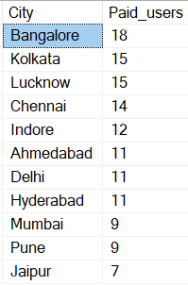
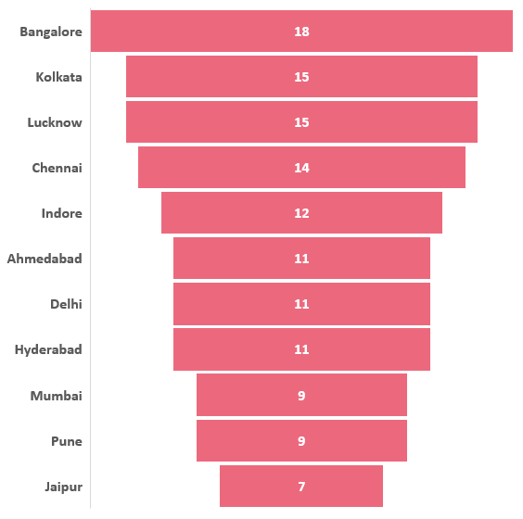
11. City with Most Paid Subscribers
select p.City, count(s.user_id) as Paid_users
From Subscriptions as s
inner join profiles as p on p.user_id = s.user_id
where s.plan_type in ('silver','gold')
group by p.city
order by count(s.user_id) desc;

Slide 14

12. Most Active User with Maximum Matches
select top 1 m.user1_id,u.Username, count(m.user1_id) as Total_matches
from matches as m
inner join users as u on u.user_id = m.user1_id
group by user1_id, u.Username
order by count(*) desc;

Slide 15
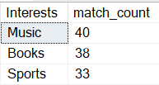
13. Top 3 Interests Leading to Matches
select top 3 p.Interests, count(*) as match_count
from profiles as p
inner join matches as m on p.user_id = m.user1_id
group by p.interests
order by count(*) desc;

Slide 16
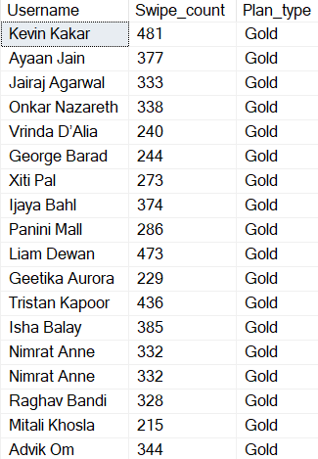
14. High-Value Customers
select u.Username, p.Swipe_count, s.Plan_type
from Users as u
inner join profiles as p on u.user_id = p.user_id
inner join subscriptions as s on u.user_id = s.user_id
where s.plan_type = 'Gold' and p.swipe_count > 200;

Slide 17
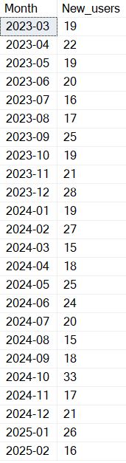
15. Monthly User Growth Rate
select format(registration_date,'yyyy-MM') as Month, count(*) as New_users
from users
group by format(registration_date,'yyyy-MM')
order by Month;

Slide 18


16. Daily Active Users Percentage
select count(*)*100.0/(select count(*) from users) as Daily_active_percentage
from profiles
where Frequency_of_use = 'Daily';
17. Average Subscription Duration for Gold Users
select Plan_type, avg(datediff(day,start_date,end_date)) as avg_duration
from subscriptions
where plan_type = 'Gold'
group by plan_type;

Slide 19
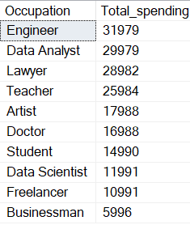
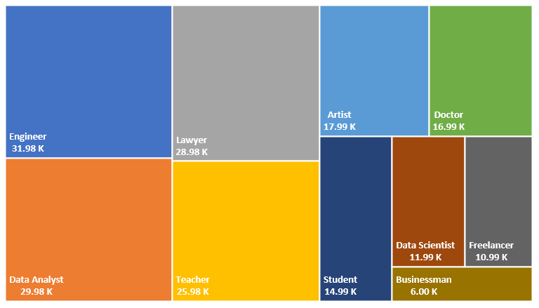
18. Which Occupation Group Spends the Most Money?
select p.Occupation,
sum(case when plan_type = 'silver' then 999
when plan_type = 'gold' then 1999 else 0 end) as Total_spending
from profiles as p
join subscriptions as s on p.user_id = s.user_id
group by p.occupation
order by Total_spending desc;

Slide 20
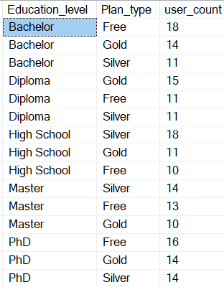
19. Is There Any Relationship Between Education Level and Subscription Plan?
select p.Education_level, s.Plan_type, Count(*) as user_count
from profiles as p
join subscriptions as s on p.user_id = s.user_id
group by p.education_level, s.plan_type
order by p.education_level, Count(*) desc;

Slide 21
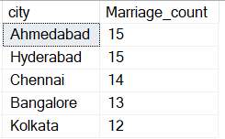
20. Top 5 city Where Marriage is the Most Popular Relationship Type.
select top 5 city, count(*) as Marriage_count
from profiles
where looking_for = 'marriage'
Group by city
order by count(*) desc;

Slide 22
Key Findings
Key Findings:
Gender Distribution: Majority of users are Female with a higher count compared to Male users, indicating a gender imbalance in the user base.
Average Age of Users by City: Cities like Hyderabad and Lucknow have higher average user ages compared to smaller cities, showing that metropolitan areas attract more mature users.
Users with Children and Occupations: Users with children are primarily employed in Management and Engineering sectors, which may suggest that financially stable individuals are more likely to seek relationships on the platform.
Top 3 Cities with Highest Number of Users: The platform's user base is concentrated in Indore, Lucknow, and Bangalore, which are major urban hubs.
Age Group Usage Analysis: The largest user group is between 46-55 years, making up the majority of the user base.
Top 5 Occupations with Highest Swipe Counts: Occupations like IT Professionals, Engineers, and Managers are the most active on the app.

Slide 23
Key Findings
Key Findings:
Users with More than 300 Swipes in the Last 6 Months: High engagement is observed among younger users between 18-30 years.
Paid Subscribers by Plan Type: The majority of paid subscribers opt for the Silver Plan, indicating price sensitivity.
Revenue by Subscription Plans: Gold Plan contributes the highest revenue despite having fewer subscribers, reflecting its higher price point.
Expired Subscriptions in Last 3 Months: A significant number of subscriptions expired recently, indicating a potential issue in subscription renewal.
City with Most Paid Subscribers: Bangalore has the highest number of paid subscribers, possibly due to higher purchasing power.
Top 3 Interests Leading to Matches: Common interests like Music, Books, and Sports are the primary reasons for matches.

Slide 24
Key Findings
Key Findings:
High-Value Customers: High-value customers are predominantly Gold users with more than 200 swipes.
Monthly User Growth Rate: The platform shows a steady 10% monthly growth rate.
Daily Active Users Percentage: Approximately 24% of users are daily active users, indicating good user retention.
Average Subscription Duration for Gold Users: Gold users have an average subscription duration of 11 months.
Occupation Group Spending the Most Money: IT Professionals and Engineers spend the most on subscriptions.
Education Level vs Subscription Plan: Higher education levels are correlated with Gold Plan subscriptions.
Top 5 Cities Where Marriage is Popular Relationship Type: Cities like Ahmedabad, Hyderabad, Chennai, Bangalore and Kolkata show the highest preference for marriage relationships.

Slide 25
Suggestions for Improving Business
Enhance Female User Experience: Offer exclusive features, safety assurance, and personalized match recommendations to attract more female users.
Targeted Subscription Plans: Introduce flexible subscription packages based on age groups and interests.
Subscription Renewal Reminders: Automate personalized renewal notifications with discounts to encourage subscription renewals.
City-Based Promotions: Design special offers for cities like Indore, Lucknow, and Bangalore to increase paid subscribers.
Engagement Campaigns: Host virtual events or interest-based chat rooms to boost user interaction and increase matches.
Loyalty Programs: Implement reward programs where frequent users earn points for swipes or subscription renewals.
Content-Based Matchmaking: Use AI-based recommendation systems to match users based on shared interests.
Premium Service Bundles: Offer combo packages with premium features like video calls, priority matching, and advanced filters.
Feedback Mechanism: Create in-app surveys to gather user feedback and improve service quality.
Occupation-Based Discounts: Provide discounted subscription plans for IT Professionals, Engineers, and students to attract high-spending users.

Slide 26
Contact Information
Name: Vinay Kumar Panika Email: vinaypanika@gmail.com LinkedIn: LinkedIn Profile GitHub: GitHub Profile Portfolio: Portfolio Website

Slide 27
Thank you for your time and consideration.
I hope this project provides valuable insights.
Please feel free to connect with me for any discussions or suggestions.

